Slide 1
AllocSmart
Smarter Portfolio Management with Reinforcement Learning

Slide 2
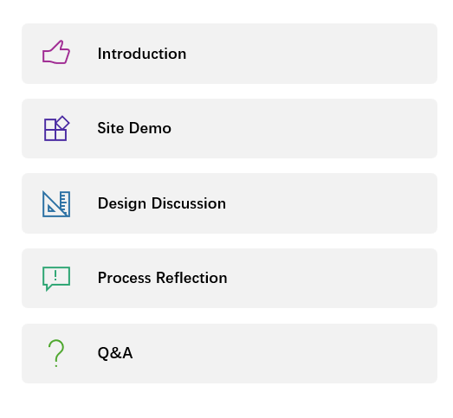
Agenda

Slide 3
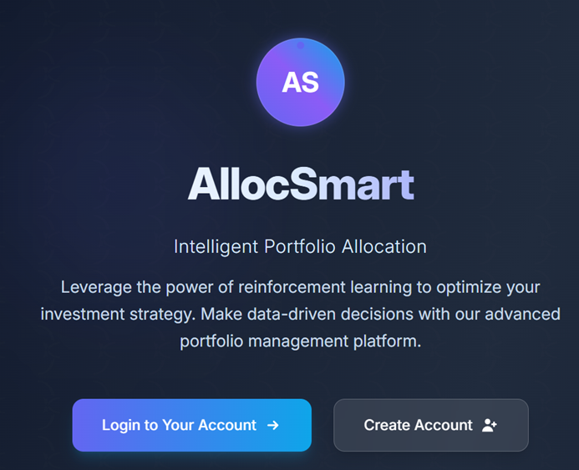
AllocSmart: Intelligent Portfolio Allocation
• What is AllocSmart?
A smart web platform that uses reinforcement learning to help users optimize their stock investment strategies.
• Key Functions:
•Set investment goals and risk preferences
•Train a personalized RL model based on your inputs
•Get dynamic, AI-powered portfolio recommendations
•Simulate transactions and track portfolio performance
•Powered by:
React, Flask, Reinforcement Learning, and cloud deployment on Duke VCM.

Slide 4
Site demonstration

Slide 5
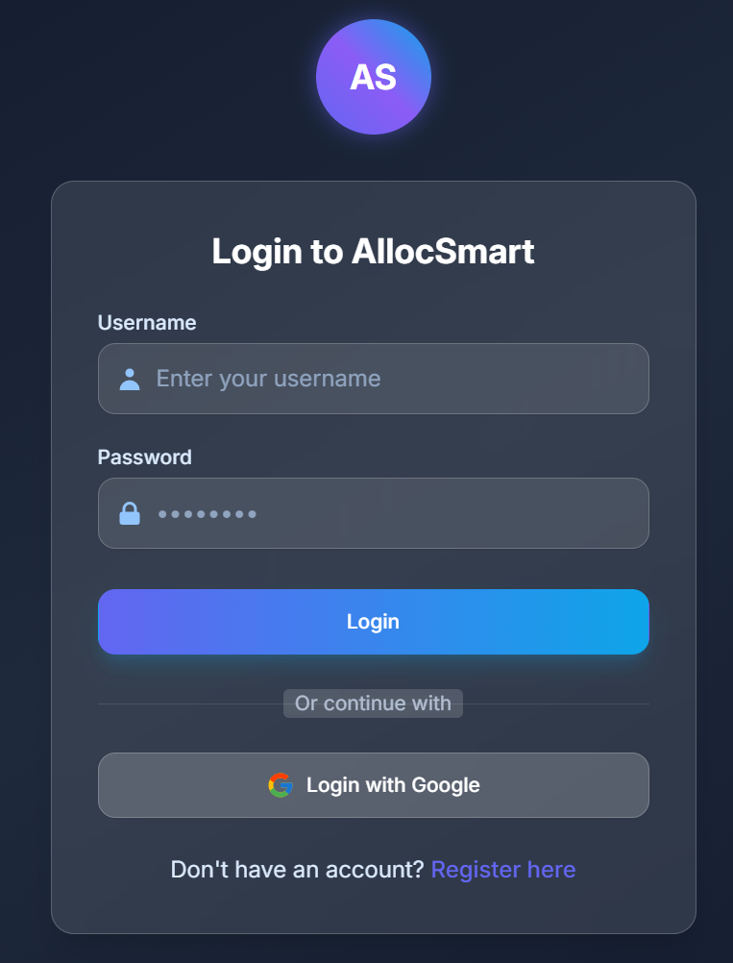
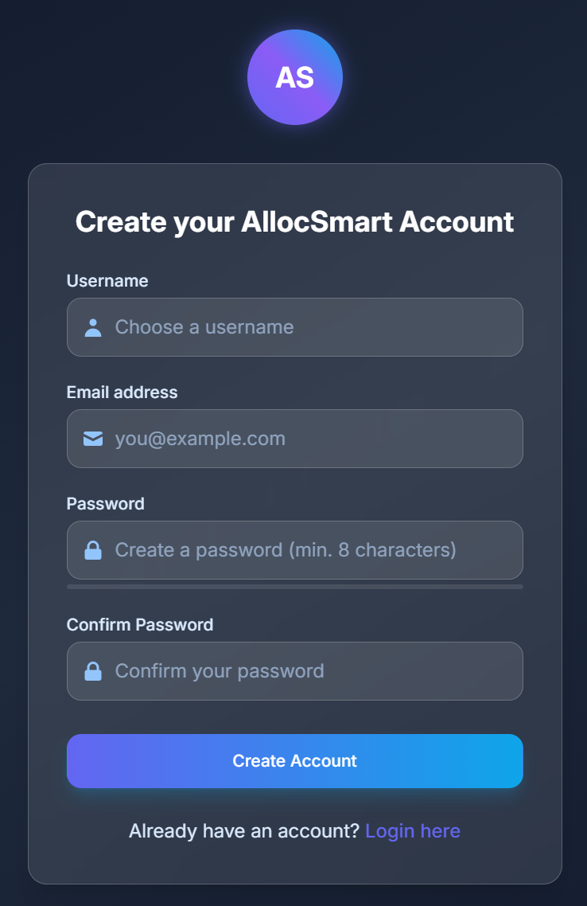
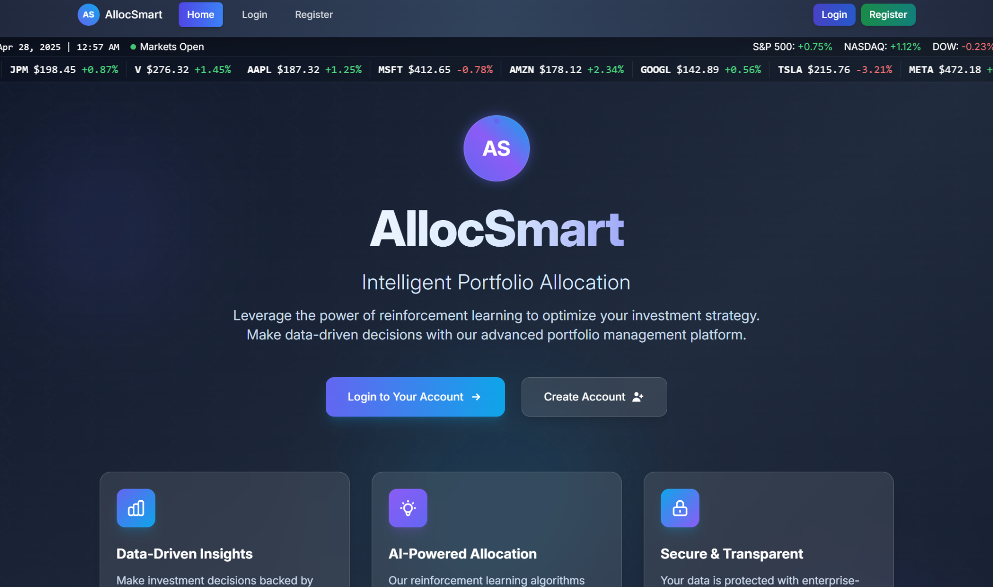
Banner: Real-Time Market Indicators
3 core values
Login
Register
Homepage Overview

Slide 6
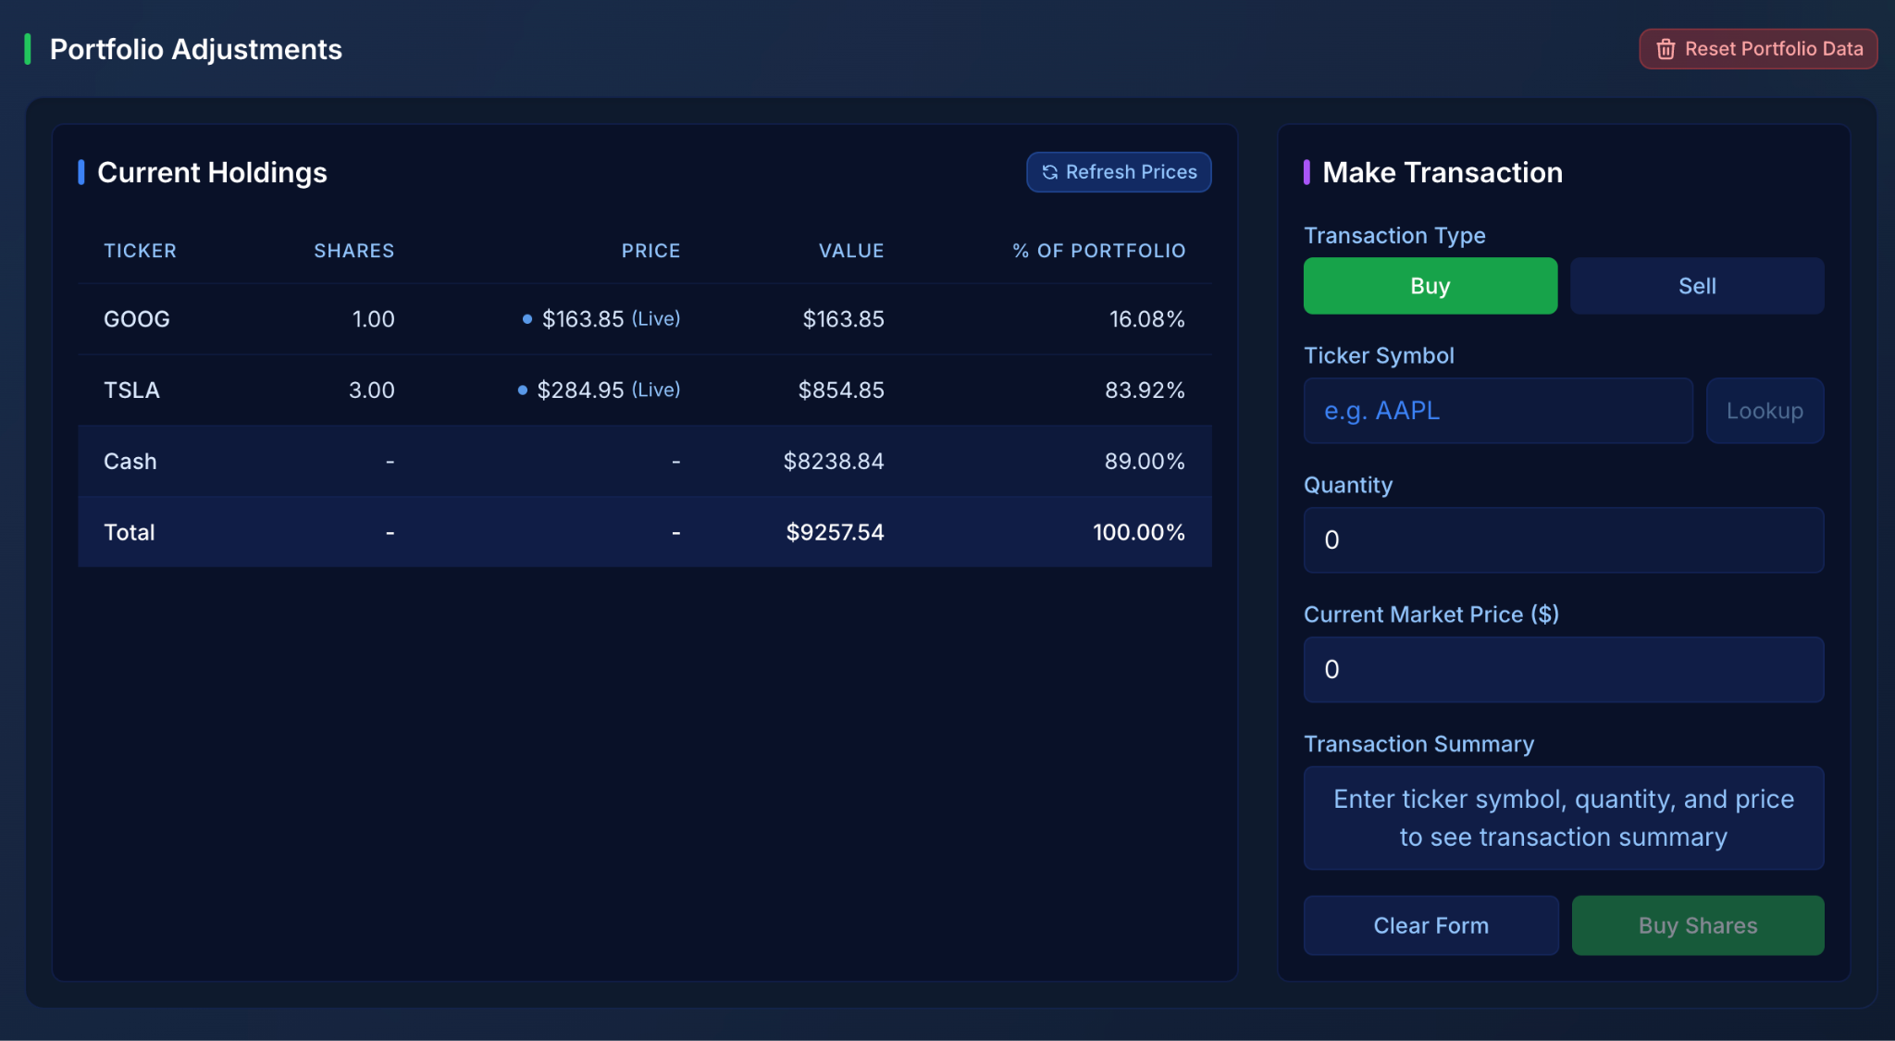
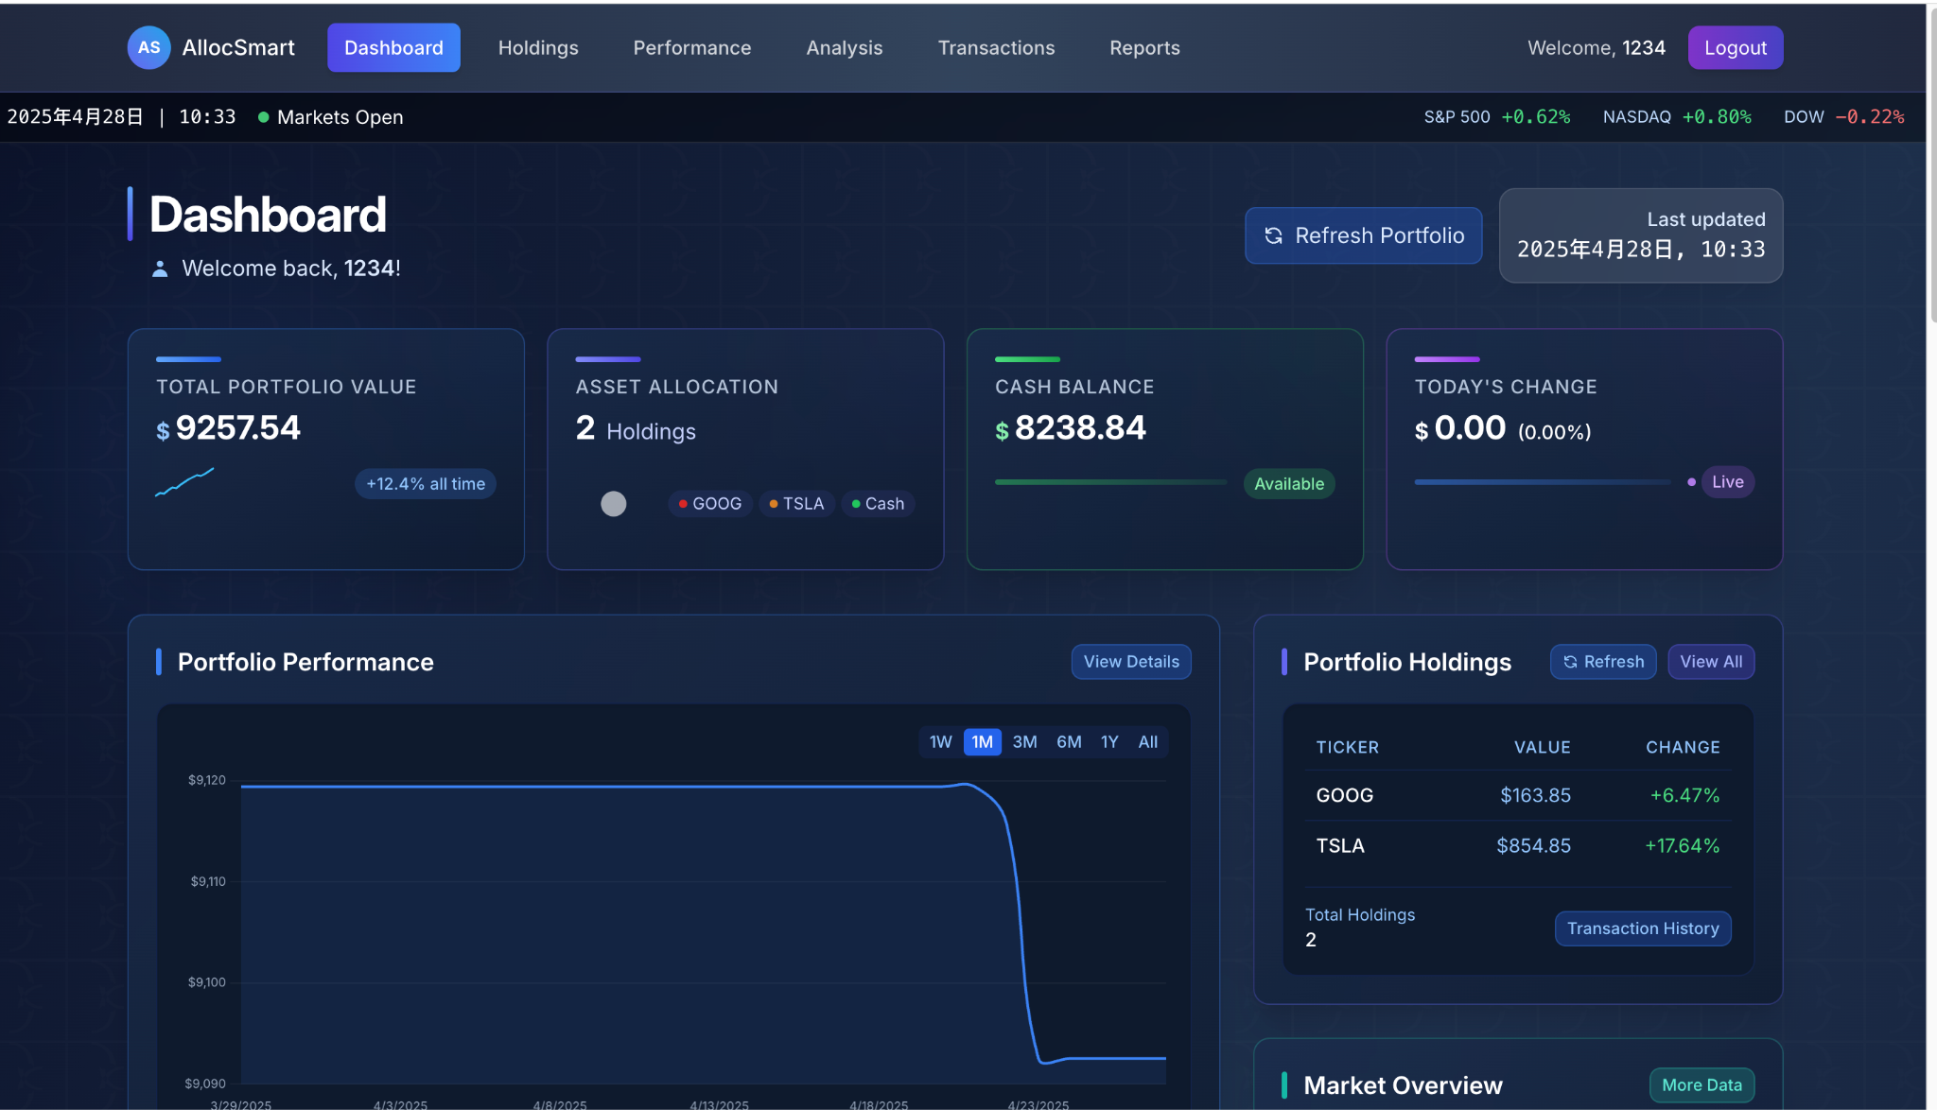
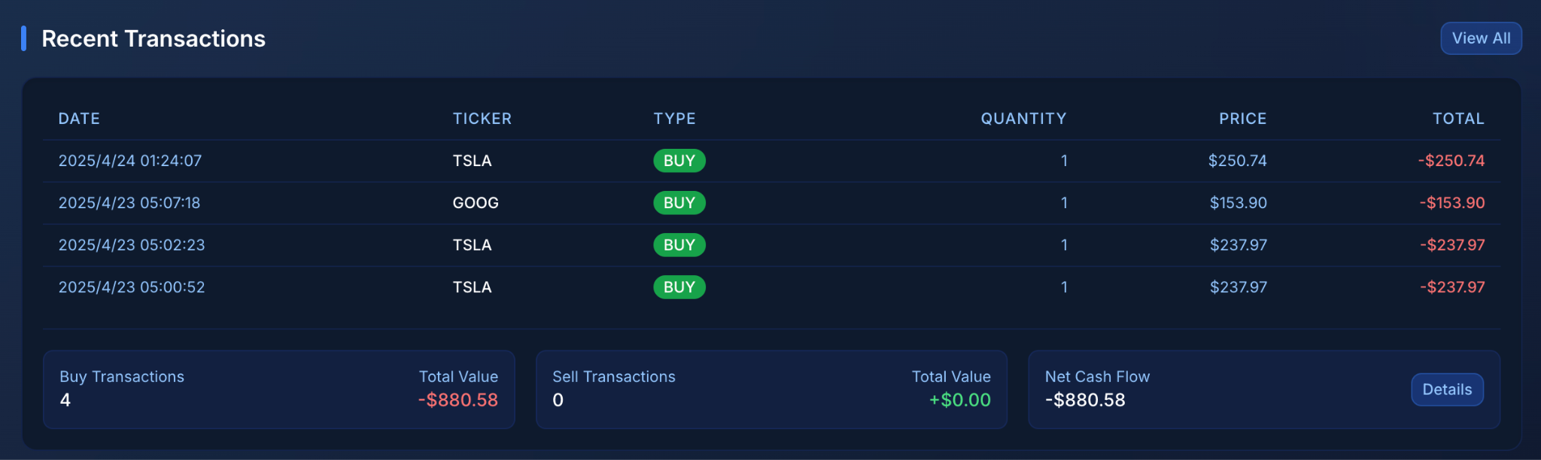
Dashboard
Overview
View total portfolio value, cash balance, and asset allocation
Track today's performance change with real-time updates
Monitor recent transactions and holding details

Slide 7
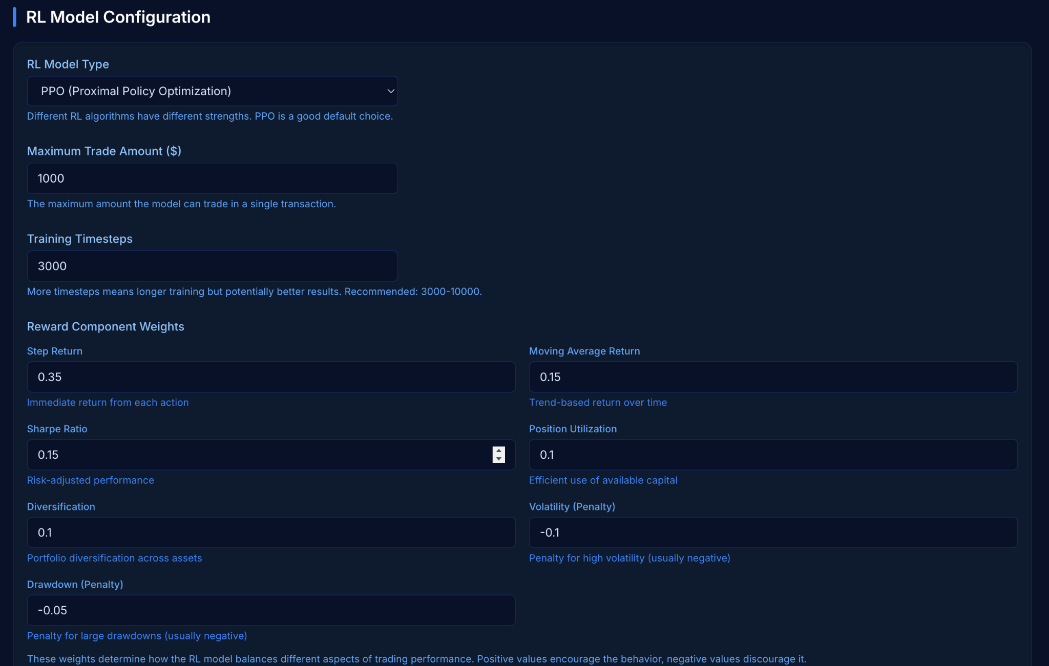
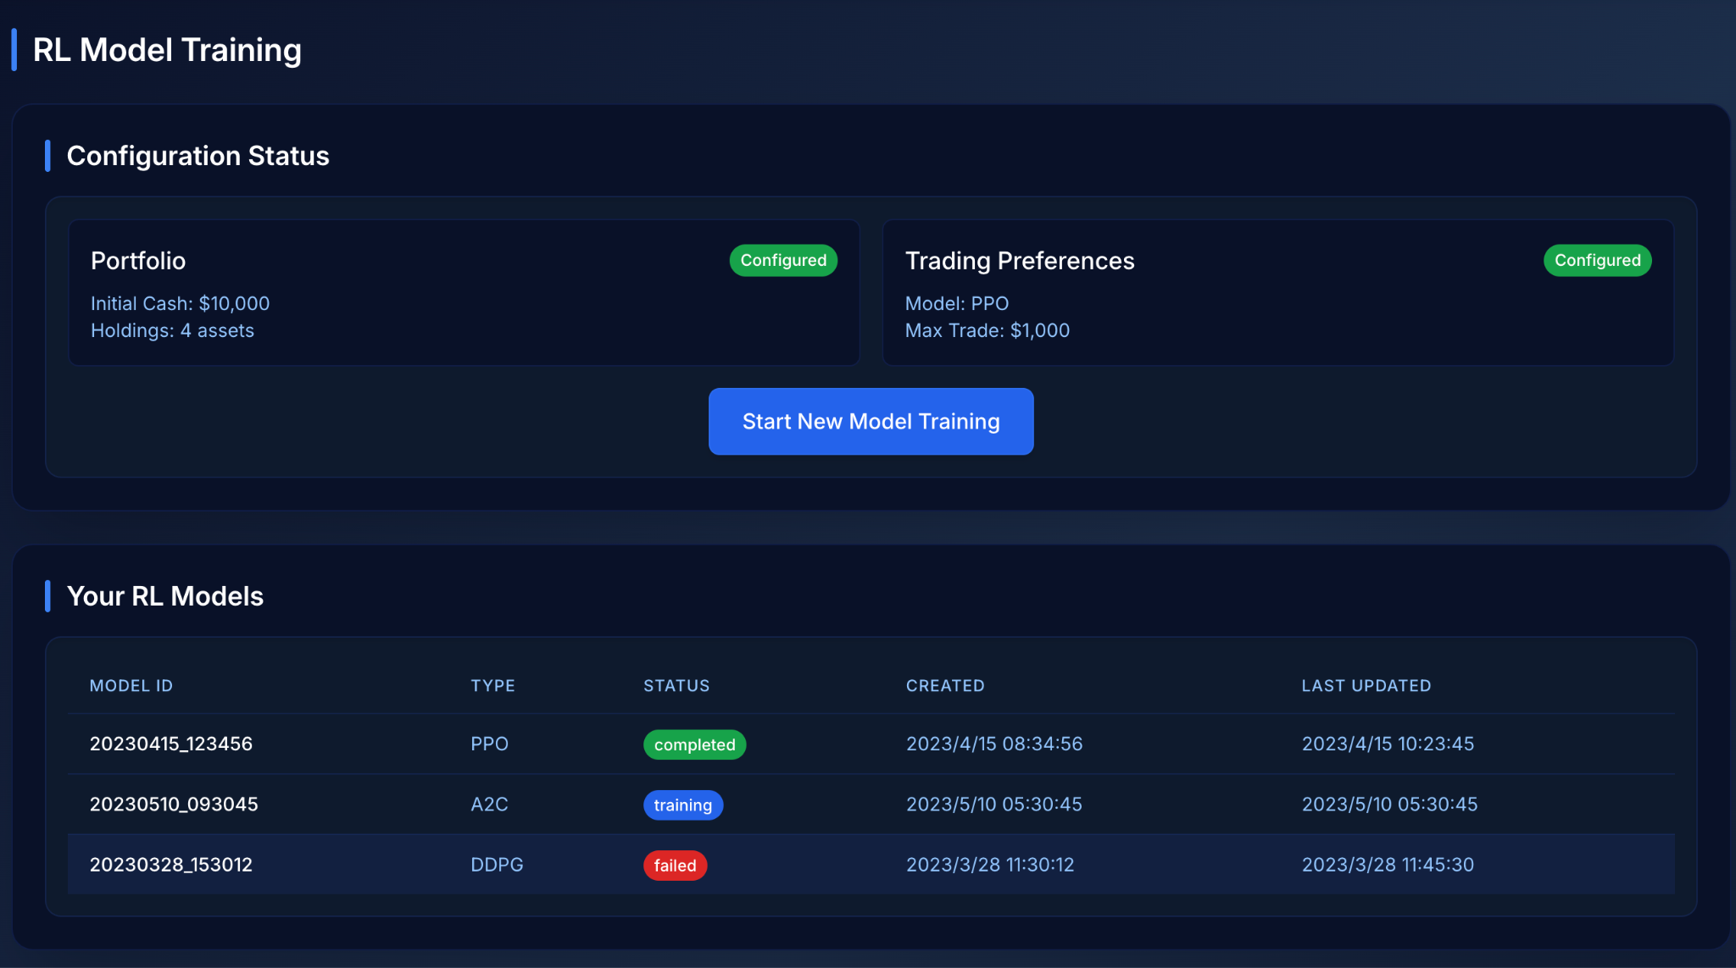
Input Parameters & Training
Customize training parameters like transaction fee and stock limits
Set reward component weights based on investment preferences
Start training a personalized RL model with one click

Slide 8
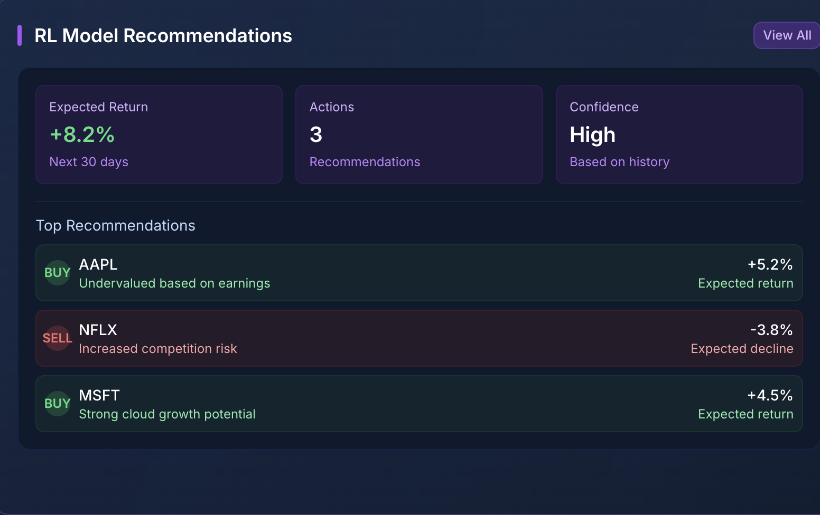
RL Model Recommendations
Receive dynamic buy/sell recommendations
View expected returns and confidence levels
Align portfolio strategy with personalized RL predictions

Slide 9
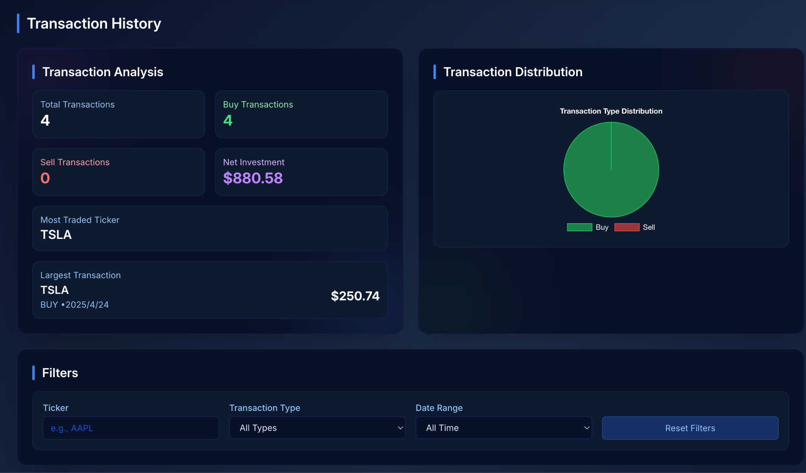
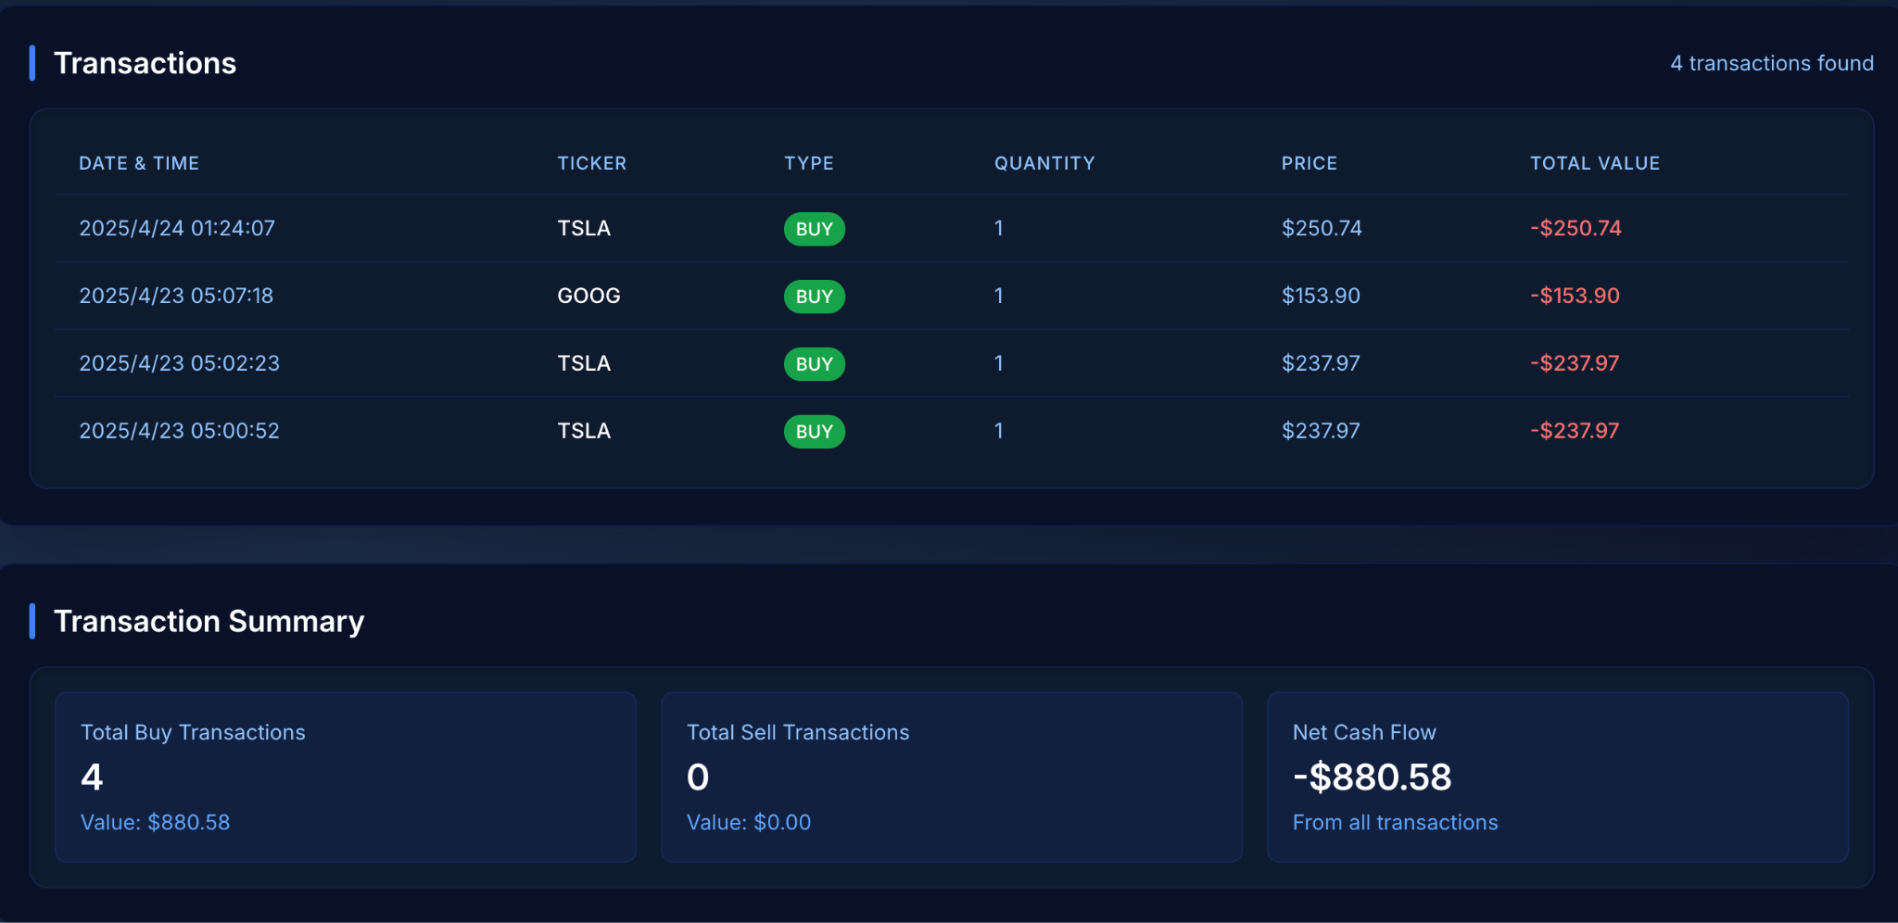
Transaction Simulator
Simulate buy/sell transactions safely
Analyze transaction history and net cash flow
Understand portfolio adjustments before committing

Slide 10
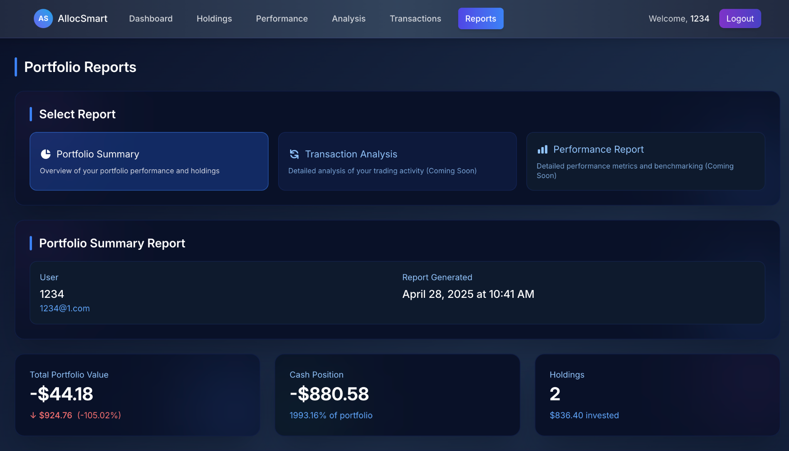
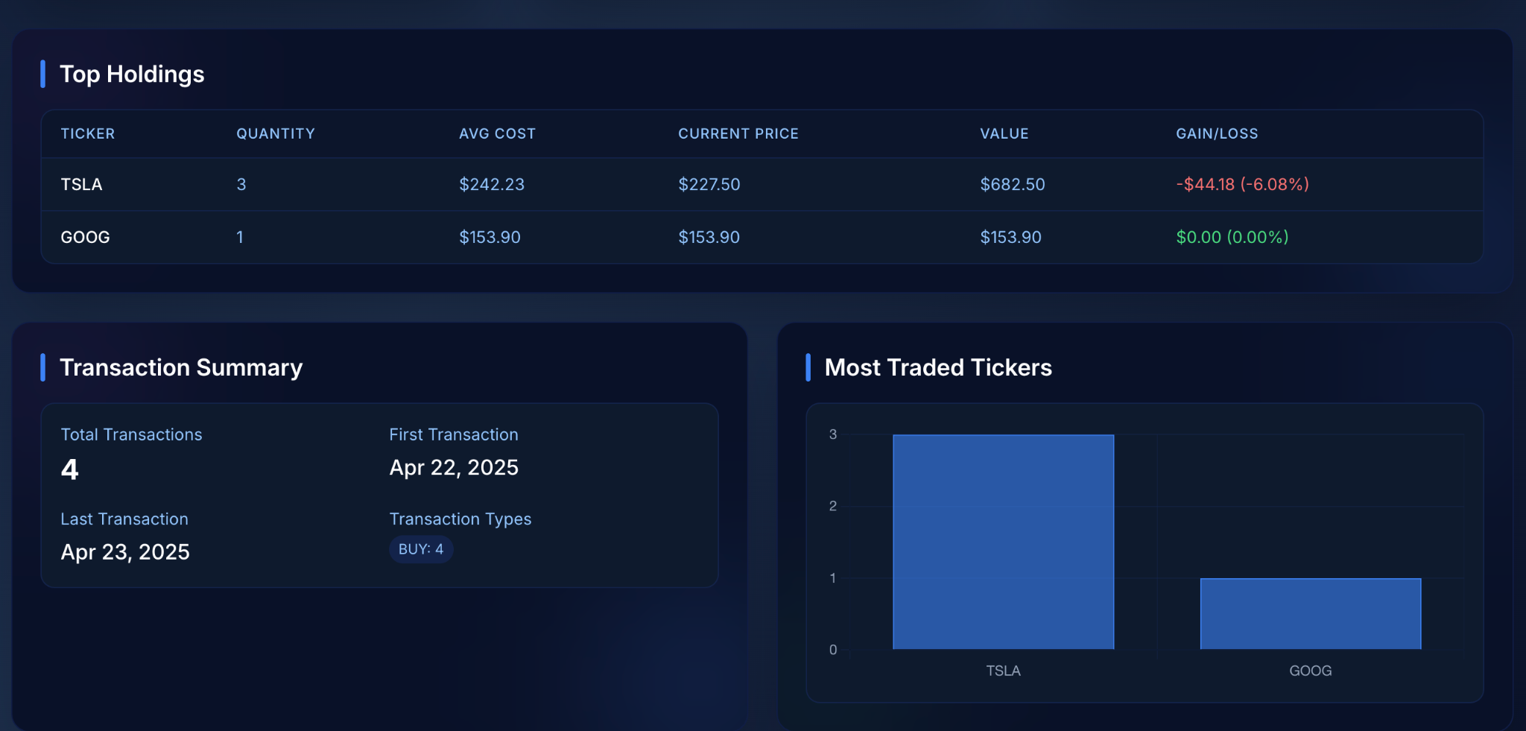
Performance Insights & Reports
Review total return, cash flow, and asset holdings
Analyze risk metrics like volatility and Sharpe Ratio
Download performance and transaction reports

Slide 11
Design Discussion

Slide 12
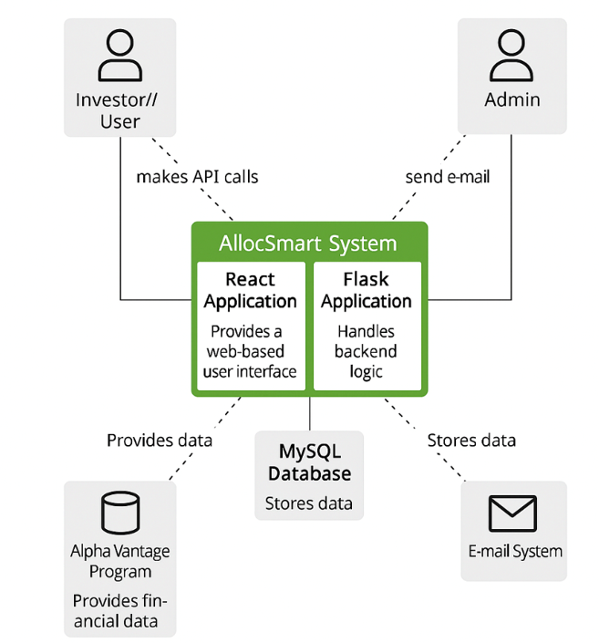
System Architecture (Container Level)
- User interacts with AllocSmart through web app
- Frontend uses React, Backend uses Flask.
- External data from AlphaVantage.
- Data stored in MySQL.
- Email system for notifications.

Slide 13
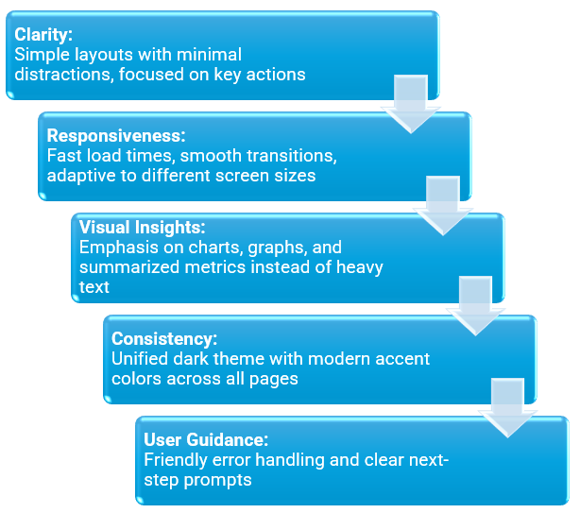
UI/UX
Design Principles

Slide 14
Thank you ：)
Q&A

